Slide 1
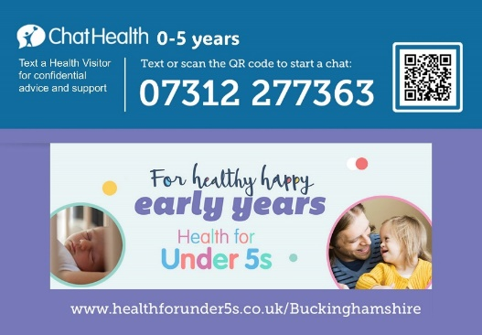
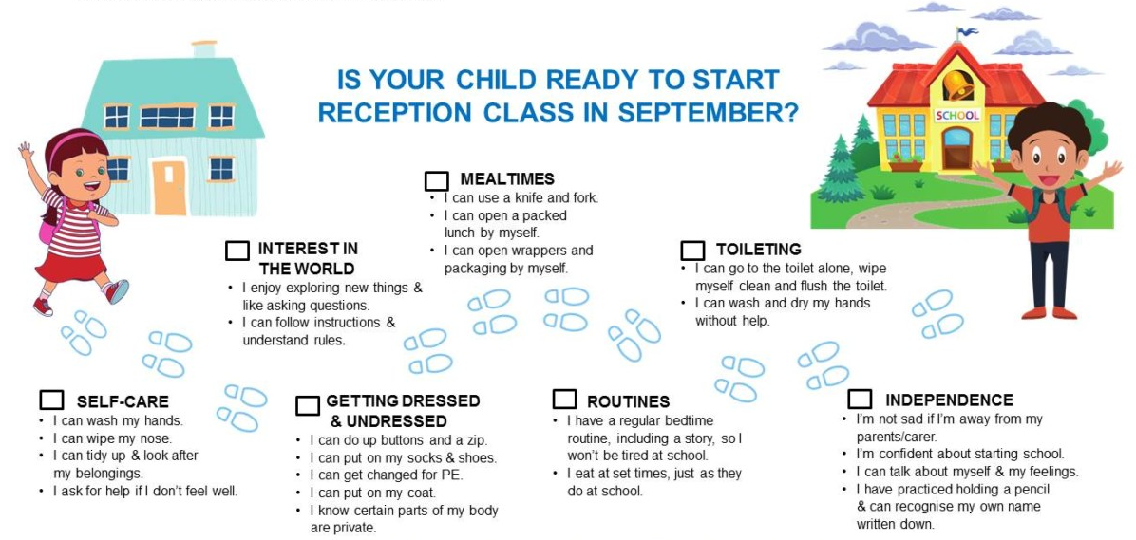
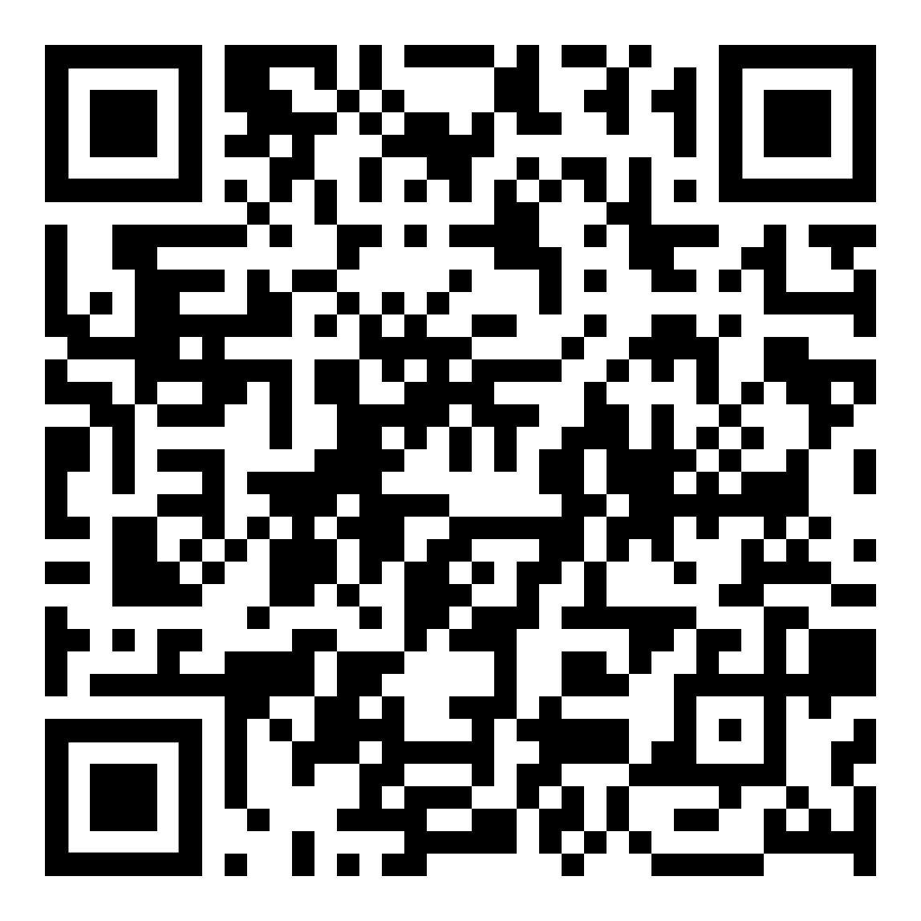
I am growing up and learning these new skills…
healthforkids.co.uk/buckinghamshire/school-readiness/
Pre-school | Health for Under 5s healthforunder5s.co.uk/preschool/

